Slide 1








MS THESIS DEFENSE
SwinIFS: Landmark-Guided Multiscale Swin Transformer for Identity-Preserving Face Super-Resolution
Presented By: Habiba Kausar
22nd Dec 2025
Thesis Committe:
Dr. Omar Jamal Hammad (Advisor)
Dr. Mahmood Khan Niazi (Member)
Dr. Saeed Anwar (Member)

Slide 2





Overview
1
6
11
Introduction
Challenges
Results
2
7
12
Problem Statement
Research Gap
Discussion
3
8
13
Research Objectives
Methodology
Conclusion
4
9
13
Research Question
Dataset
Future Work
5
10
13
Experimental Setup
Research Outcomes
Literary Review

Slide 3







Introduction
Face Super-Resolution (FSR) is a fundamental computer vision problem aims to reconstruct high-resolution facial images from low-resolution inputs.
Unlike general SR, face SR must preserve identity, structure, and fine-grained details accurately.
Reconstructing facial components such as eyes, nose, and mouth is challenging due to missing high-frequency identity cues.

Slide 4






Introduction (4x)
In the 4x upscaling setting, low-resolution face images are 32×32 pixels.
Many fine details are missing, but basic structure is still visible.
The goal is to reconstruct a 128×128 high-resolution face from this limited input.
4x : 32x32 → 128x128
Simple interpolation produces blurry and smooth results.
Effective FSR must recover sharp features, preserve identity, and maintain facial geometry.

Slide 5


Introduction (4x)
Low Resolution
High Resolution

Slide 6
Introduction(8x)
In the 8x upscaling setting, face images are extremely small only 16×16 pixels.
At this scale, most identity details disappear, making reconstruction very challenging.
The goal is to generate a 128×128 high-resolution face from this minimal visual information.
8x : 16x16 → 128x128
The problem becomes highly ill-posed, and standard SR methods fail to preserve facial structure.

Slide 7
Introduction(8x)
Low Resolution
High Resolution

Slide 8
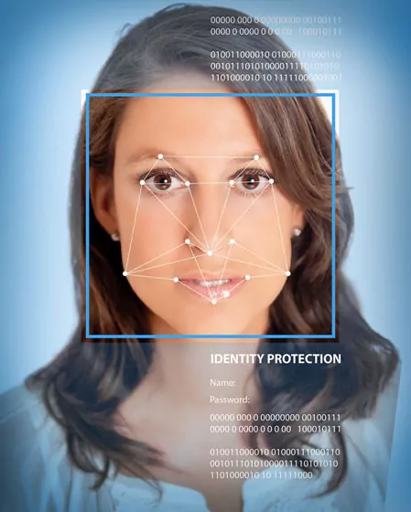



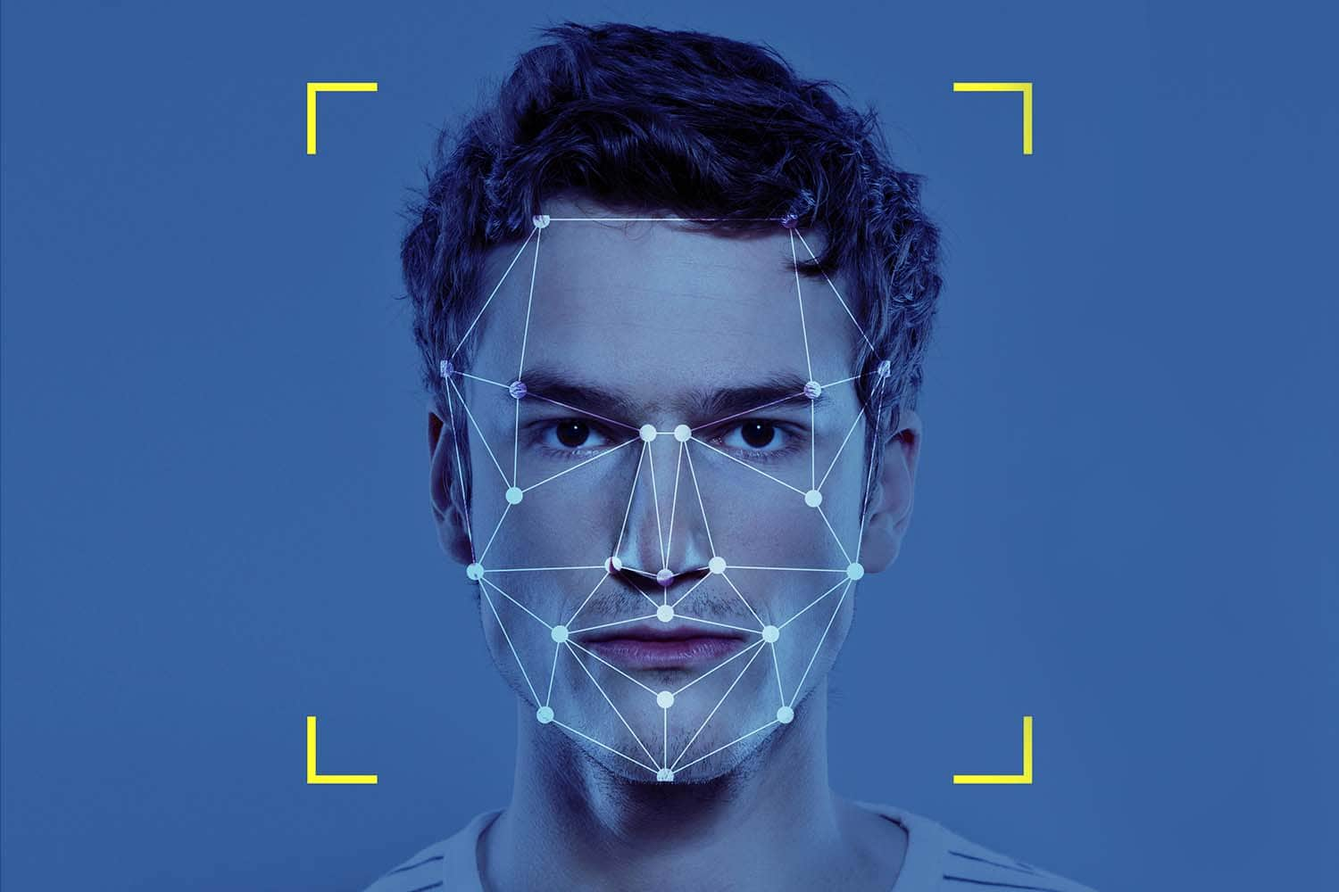


Applications
Forensic analysis
Surveillance and security systems
streaming media
biometric identification and face recognition
social platforms
video calls
human–computer interaction systems

Slide 9
Problem Statement
Reconstructing an accurate 128×128 high-resolution face from severely degraded low-resolution inputs is challenging.
LR images (especially 16×16) contain insufficient identity and geometric information.
Existing super-resolution methods fail to jointly preserve texture, structure, and identity.
There is a need for a model that can reliably recover missing facial geometry, fine details, and identity consistency across multiple scales (4× and 8×).
The core problem: How can we reconstruct realistic, identity-preserving HR faces from extremely limited LR information?

Slide 10





Research Objectives
1
2
3
Develop a Landmark-Guided Face SR Framework
Evaluate Performance Against State-of-the-Art Methods
Multi-Scale Face Super-Resolution
Design a face super-resolution model that integrates facial landmark heatmaps with image features to strengthen geometric priors and improve structural and identity preservation.
Build a unified Swin Transformer–based architecture capable of reconstructing high-quality faces from moderate (4×) and extreme (8×) low-resolution inputs.
Assess SwinIFS using quantitative metrics (PSNR, SSIM, LPIPS) and qualitative comparisons to determine improvements over existing methods.

Slide 11




Research Questions
1
RQ#1: How can landmark-guided priors improve structural consistency and identity preservation in face super-resolution? w can landmark-guided priors improve structural consistency and identity preservation in face super-resolution?
2
RQ#2: To what extent can a Swin Transformer–based framework enhance reconstruction quality at 4× and 8× upscaling levels?

Slide 12





Literature Review
Traditional / Interpolation Methods
Joint SR–Alignment (DIC)
Transformer-(attention based)FSR (W-Net, UFSRNet)
Bicubic, Lanczos, and patch-based upsampling.
Fast but produce blurry faces and fail to preserve identity.
Jointly update SR output and facial landmarks in iterative refinement.
Improve alignment, but models are complex, slow, and sensitive to landmark errors.
Self-attention models long-range relationships across the face
Capture global context but lack explicit structural priors and struggle under extreme degradation (8×)
CNN-Based FSR (SRCNN, FSRNet, Super-FAN)
GAN-Based Perceptual FSR (SRGAN,SPARNet)
Deep CNNs
Improve structure but lack global modeling.
Landmark accuracy drops at very low resolutions distorted and unstable identity.
Use adversarial and perceptual losses for sharper, realistic textures.
Fail to maintain global structure, hallucinate identity-distorting details.

Slide 13
Challenges and Limitation
Loss of high-frequency details (eyes, lips, contours)
Difficult identity preservation at 8×
Highly ill-posed LR → HR mapping
CNNs: limited receptive field, weak global structure
GANs: hallucinated textures, identity distortion
Transformers: lack explicit facial structural priors
High computational cost limits practicality of many Transformer-based models.
Real-world degradations: noise, blur, compression, pose variations

Slide 14



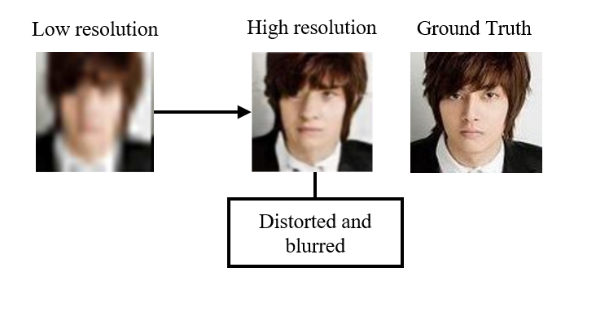
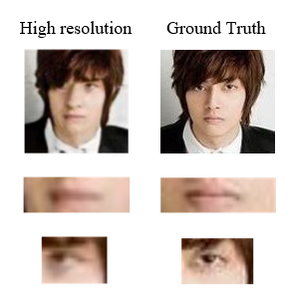

Research Gap
Existing face super-resolution methods often lack explicit structural priors, resulting in misaligned features and weak identity preservation.
Current models struggle under extreme degradation (especially 8×), producing blurry or hallucinated details instead of realistic identity-consistent reconstructions.

Slide 15
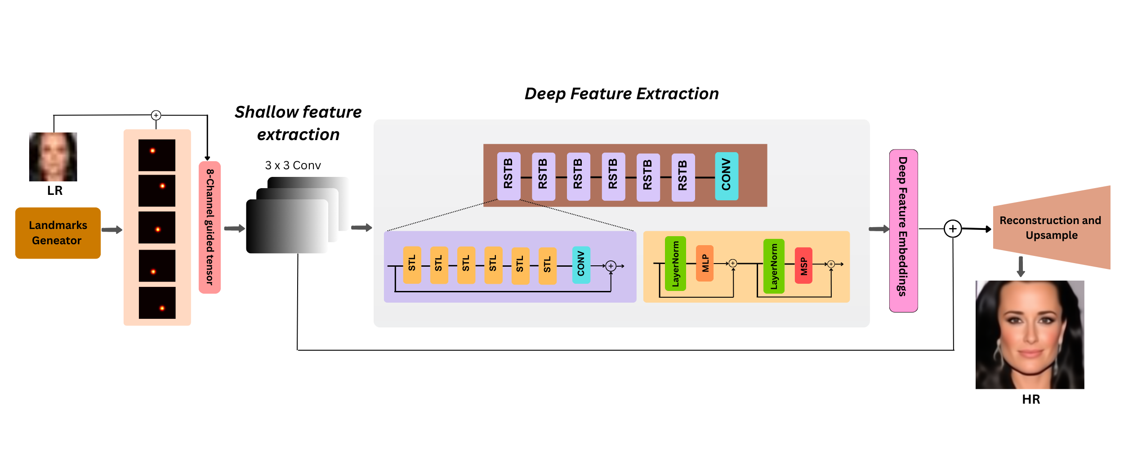
Methodology

Slide 16


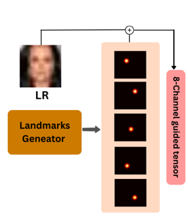



Start with Low-Resolution (LR) face image (32×32 for 4×, 16×16 for 8×).
Extract 5 facial landmarks (eyes, nose, mouth) from CelebA landmark CSV.
Convert each landmark into a 2D Gaussian heatmap.
Stack all 5 heatmaps → 5-channel landmark tensor.
Concatenate LR RGB (3 channels) + landmark heatmaps (5 channels).
Form a unified 8-channel guided input tensor.

Slide 17
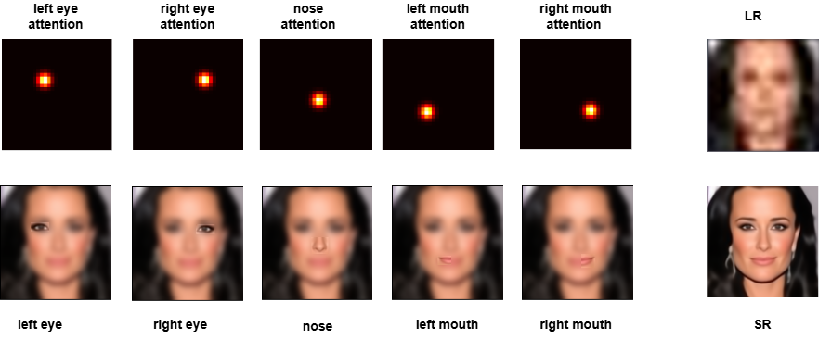
Landmark Heatmap Guidance
Each landmark (eyes, nose, mouth) is converted into a Gaussian heatmap showing its exact location.
Heatmaps act as structural attention cues for the network.
Guide the model to focus on identity-critical facial regions:
Eyes → sharper symmetry
Nose → accurate shape
Mouth → better contours
Help reduce hallucination and preserve true identity.
Improve reconstruction of fine facial details in the final SR output.

Slide 18
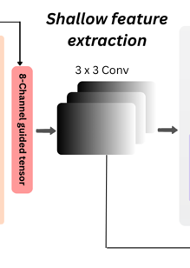
Shallow feature Extraction
Input:
8-channel tensor (3 RGB + 5 heatmaps)
Apply 3×3 convolution
Extract low-level spatial features
Merge RGB + landmark cues
Produce high-dimensional feature map
Output:
Feature dimension expanded to 180 channels
180-channel tensor passed into RSTBs

Slide 19


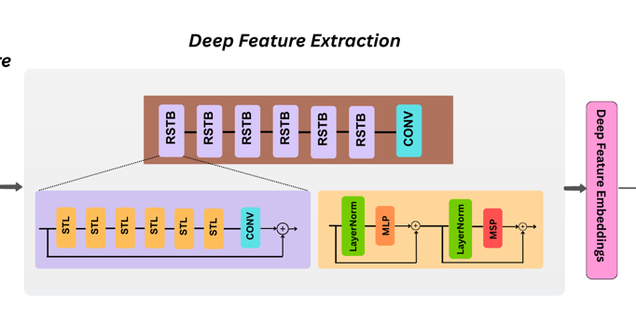


Deep Feature Extraction
180-channel feature map.
Processed through stacked RSTBs (Residual Swin Transformer Blocks).
Each RSTB contains multiple STLs (Swin Transformer Layers)Local + global context captured via window / shifted-window attention.
MLP + LayerNorm refine feature representations.
Residual connections maintain feature stability.

Slide 20
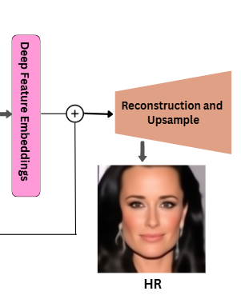
Reconstruction & Upsample
Receive deep feature maps from RSTBs.
Apply a 3×3 convolution to reduce channel dimensions for efficient upsampling.
Perform PixelShuffle-based upsampling to increase spatial resolution.
Upscale feature maps to the high-resolution size (128×128).
Apply a 3×3 reconstruction convolution to refine spatial details.
Incorporate a bicubic-upsampled LR skip connection to preserve low-frequency information.
Produce a sharp and identity-preserving super-resolved (SR) face image.

Slide 21
Loss Function
L1 Reconstruction Loss
Minimizes pixel-wise difference between SR and HR images.
Encourages sharper, less blurry outputs
Perceptual Loss(VGG)
Compares SR and HR in deep feature space
Improves texture realism and fine detail recovery
Unexpected Findings
Total Loss
Combined objective: L1 + VGG
Balances pixel accuracy and perceptual quality

Slide 22






Dataset
CelebA contains 202,599 face images
10,177 unique identities
Original size: 178 × 218 pixels
High variation in pose, expression, lighting, and occlusions
Large and diverse dataset for identity-preserving face SR
Unexpected Findings

Slide 23






Dataset Preprocessing
Detect 5 facial landmarks for each image
Perform structure-aware cropping around the landmarks (removes background)
Resize cropped face to 128 × 128 (HR)
Generate LR images via bicubic downsampling:
32 × 32 for 4× SR
16 × 16 for 8× SR
Final prepared data: HR image + LR image + 5 heatmaps(.npy)

Slide 24
Train and Test
CelebA official train/test partition used
Training set: 168,854 images
Testing set: 1,000 images (identity-disjoint)
No overlap between training and testing identities
Both 4× and 8× SR use the same train/test identities
HR, LR, and heatmap pairs created separately for each split
Ensures fair evaluation and reliable generalization

Slide 25
Experimental Setup
GPU
Python Version
Training Batch Size
NVIDIA RTX A6000 (48 GB)
Python 3.9
16
DL Framework
Learning Rate
Loss Functions
PyTorch ≥ 1.13
1 × 10⁻⁴ (with MultiStep decay)
L1 Loss + VGG Perceptual Loss
CUDA Toolkit
Input Channels
Optimizer
CUDA ≥ 11.3
8 (RGB + 5 heatmaps)
Adam (β₁ = 0.9, β₂ = 0.999)

Slide 26




Evaluation Metrix
PSNR(Peak Signal-to-Noise Ratio)
SSIM (Structural Similarity Index)
Measures pixel-level reconstruction accuracy
Higher PSNR → better fidelity
Measures structural consistency & perceptual similarity
Higher SSIM → better preserved facial structure
LPIPS (Learned Perceptual Image Patch Similarity)
Measures perceptual similarity in deep feature space
Lower LPIPS → more realistic & identity-faithful output

Slide 27
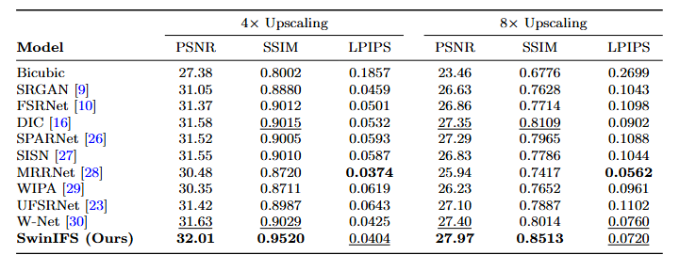
Quantitative Results
GPU
NVIDIA RTX A6000 (48 GB)

Slide 28

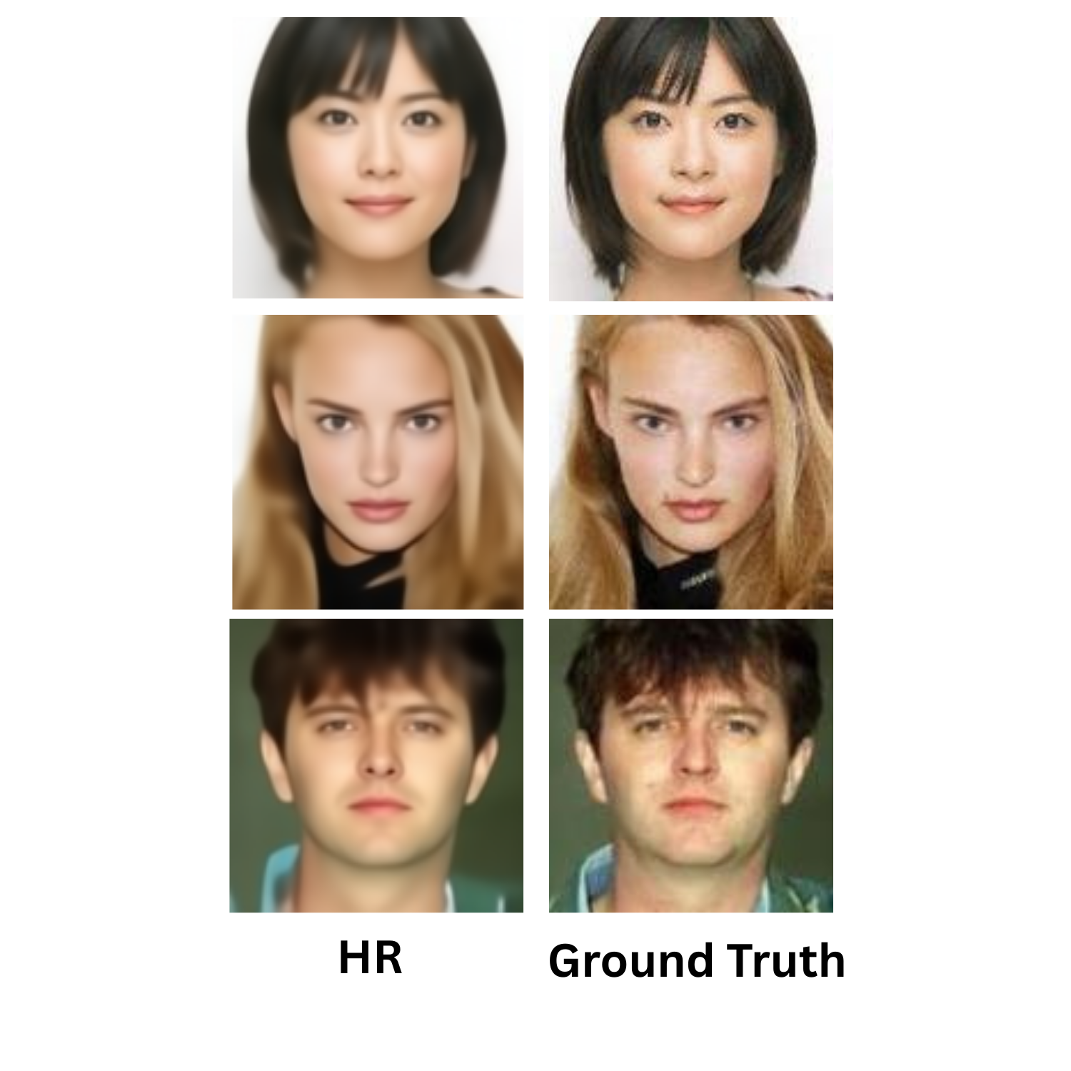


Qualitative Results: 4x
LR

Slide 29
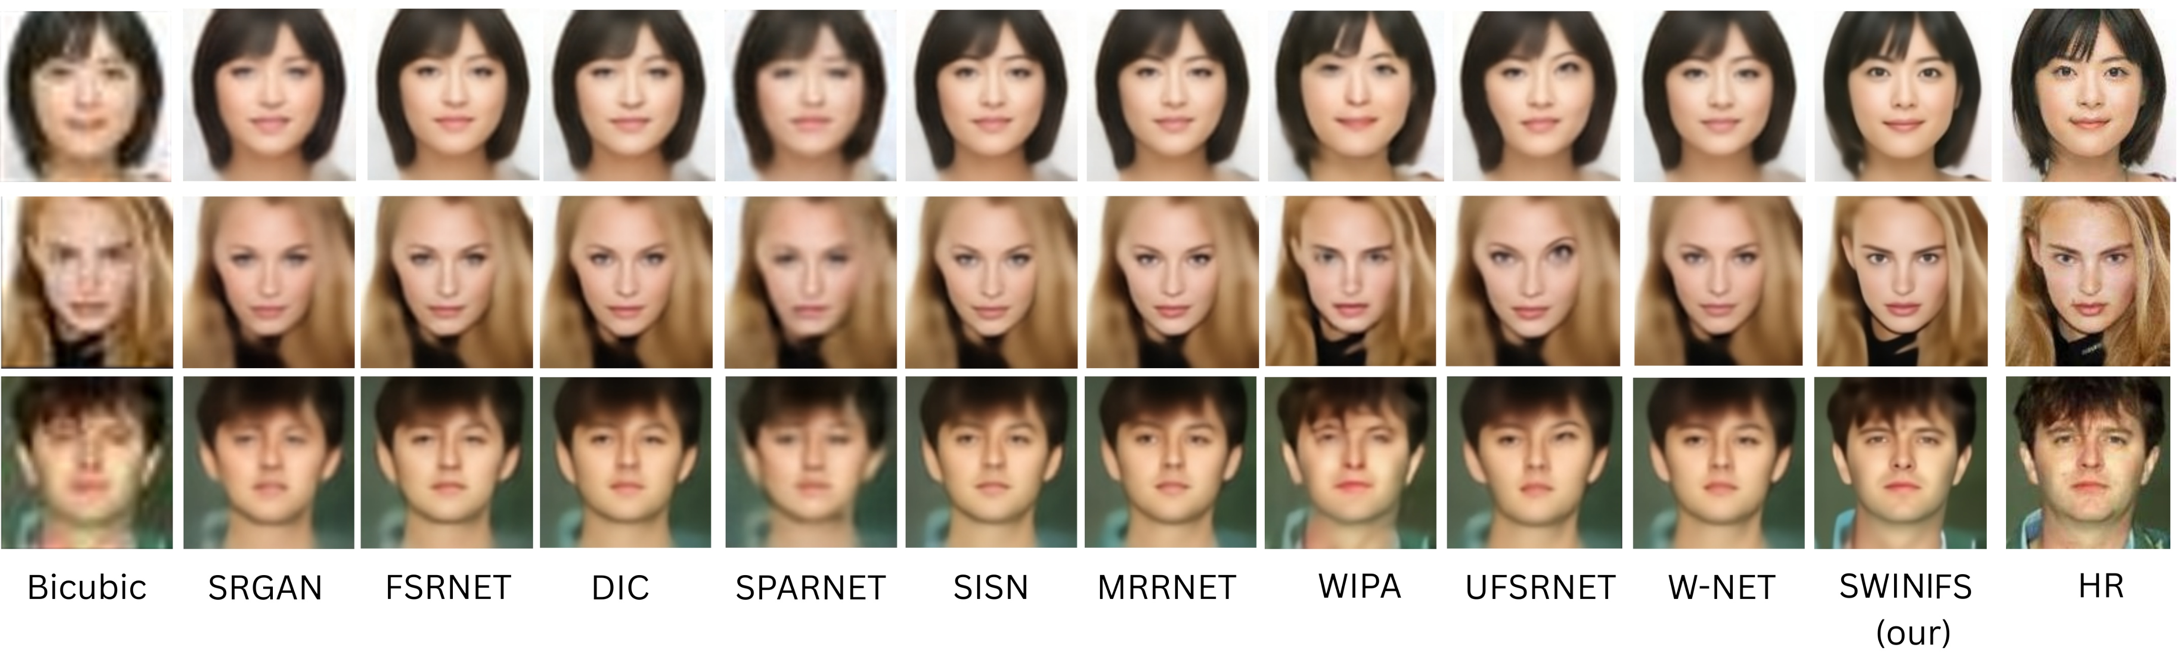
Comparison: 4x

Slide 30
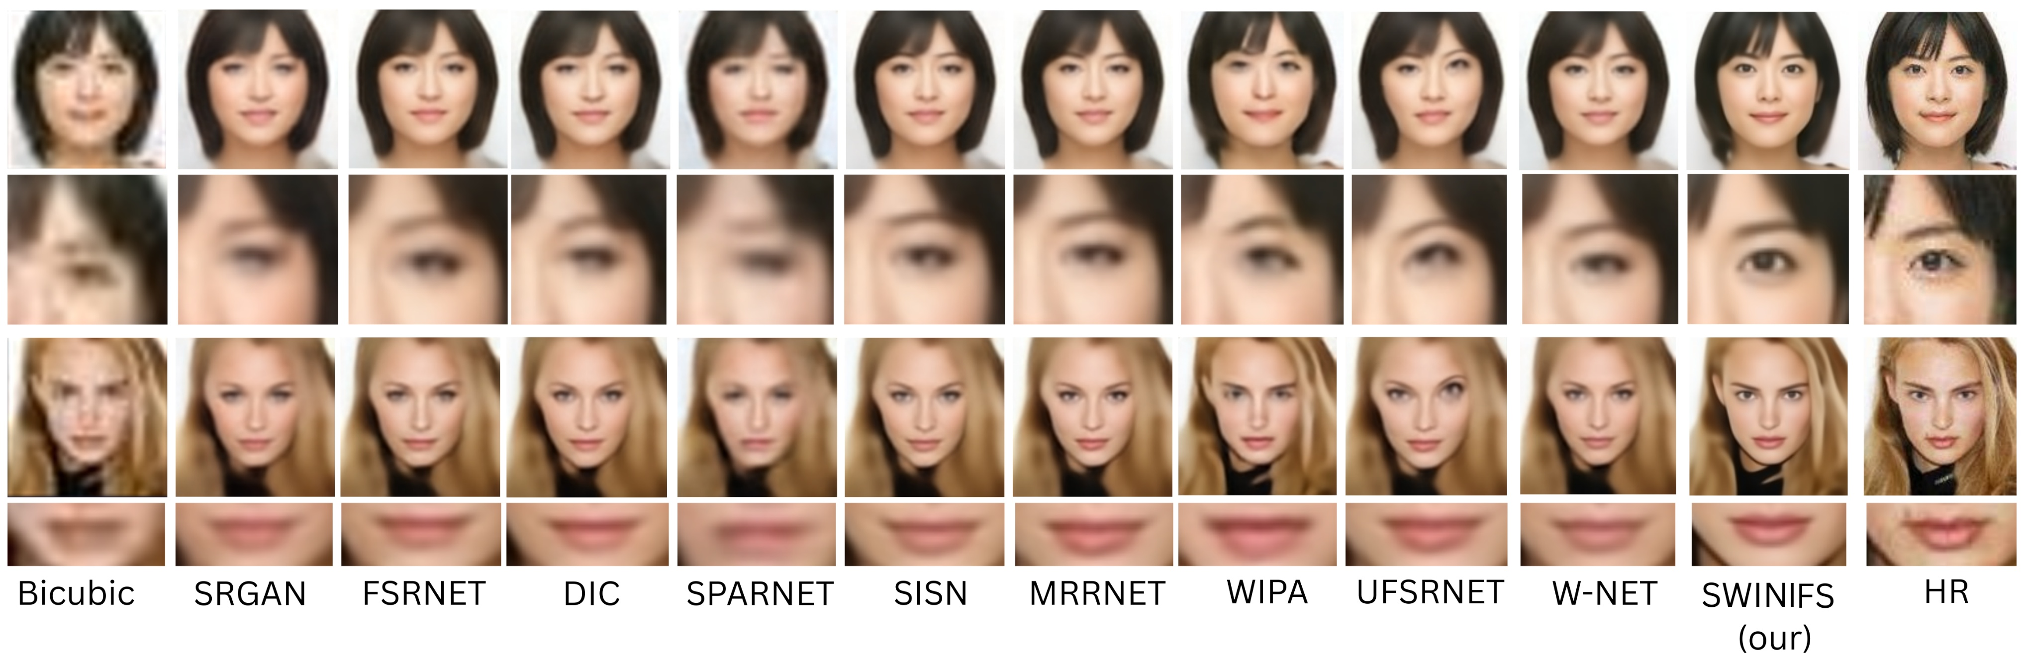
Zoom-in Results : 4x

Slide 31
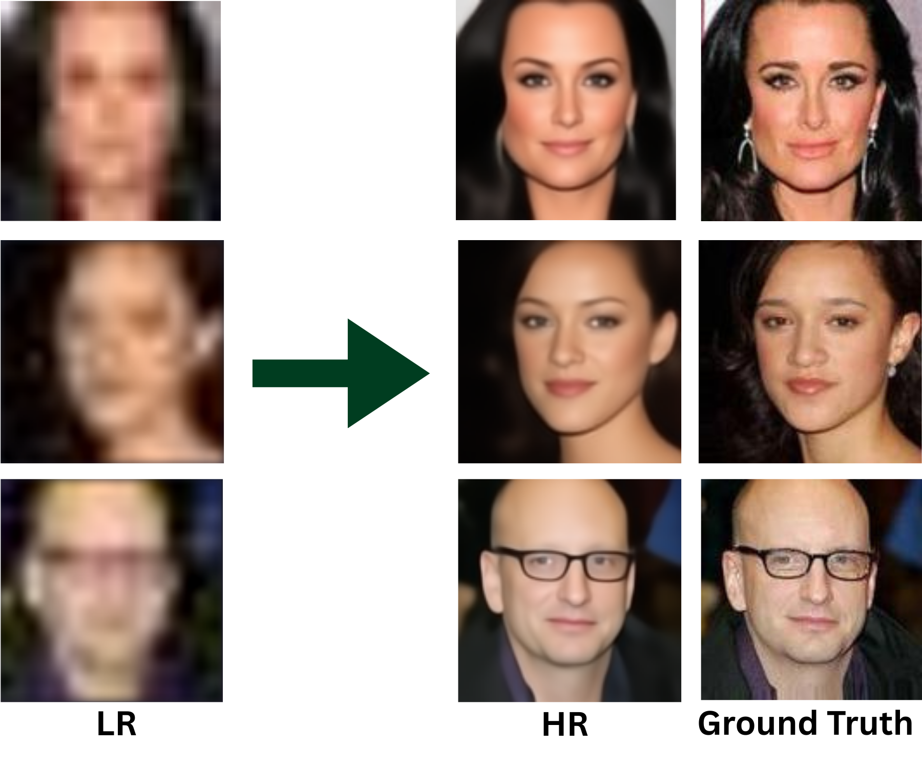
Qualitative Results : 8x

Slide 32
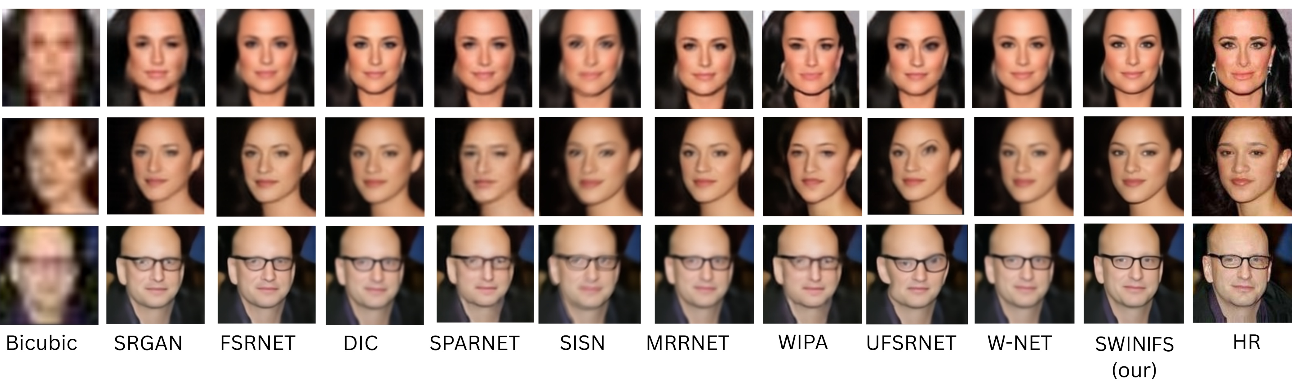
Comparison: 8x

Slide 33
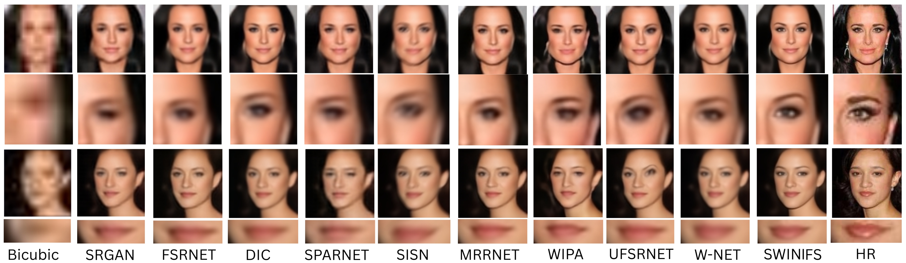
Zoom-in Results : 8x

Slide 34
Discussion
SwinIFS demonstrates strong capability in recovering identity-preserving facial details, even under severe degradation (especially 8× SR).
Landmark-guided priors significantly enhance structural alignment, helping the model reconstruct eyes, nose, and mouth more accurately than existing methods.
The Swin Transformer backbone effectively captures both local texture and global facial context, reducing distortions and unnatural artifacts.
Compared to CNN, GAN, and previous Transformer-based models, SwinIFS provides a better balance between fidelity, perceptual realism, and computational efficiency.

Slide 35
Discussion
Results indicate that incorporating geometric priors (heatmaps) reduces hallucination and improves robustness to pose, illumination, and occlusion variations.
Despite improvements, extreme cases of low resolution still pose challenges, and performance remains sensitive to landmark detection accuracy.

Slide 36
Efficiency vs. Quality Trade-Off
SwinIFS achieves the highest PSNR for 8× face super-resolution while maintaining low inference time.
It offers an optimal balance between reconstruction quality and runtime efficiency, outperforming heavier Transformer- and GAN-based methods.
Other models are either slower for small quality improvements or produce lower-quality results at similar runtime.
SwinIFS provides the best quality-to-speed ratio, making it suitable for practical and real-time deployment.

Slide 37
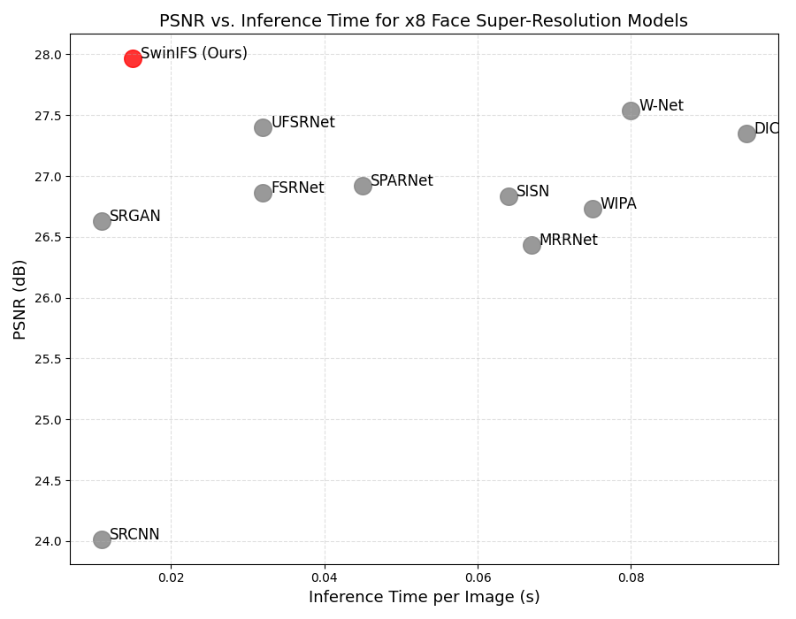
Efficiency vs. Quality Trade-Off

Slide 38
Limitation
Model is trained and evaluated only on CelebA; performance on other datasets may vary.
SR quality may decrease in cases of extreme poses, heavy occlusion, or very noisy inputs.
Landmark-based guidance relies on correct landmark detection, which may fail in some conditions.
Further improvement is needed for handling real-world, unconstrained images outside controlled datasets.

Slide 39
Conclusion
Proposed SwinIFS, a landmark-guided Swin Transformer for 4× and 8× face SR.
Landmark heatmaps provide strong structural priors, improving alignment and identity preservation.
Swin Transformer captures local + global facial context, enabling high-quality reconstruction from severely degraded inputs.
Hybrid L1 + VGG loss enhances both pixel accuracy and perceptual realism.
Experiments on CelebA show SwinIFS outperforms CNN, GAN, and Transformer baselines.
Overall, combining geometric priors with hierarchical attention yields more stable and identity-consistent face SR.

Slide 40
Future Work
Extend the model to additional and more diverse datasets (e.g., FFHQ, CelebA-HQ, real-world unconstrained faces).Improve robustness to extreme poses, occlusions, and illumination variations.
Explore stronger structural priors such as facial parsing maps, 3D face models, or attention-guided masks.
Reduce reliance on landmark accuracy by developing heatmap refinement or landmark-free guidance mechanisms.
Optimize the model for real-time inference and deployment on edge devices.
Investigate extensions to video face super-resolution with temporal consistency.
Incorporate adversarial or identity-based losses to further enhance perceptual realism.

Slide 41

Research Outcome
Machine Vision and Application Journal:
Title: SwinIFS: Landmark-Guided Swin Transformer For Identity-Preserving Face Super-Resolution.
Status: Under Review
Github Link:
https://github.com/Habiba123-stack/SwinIFS.git
Google Drive Link (Our results):
https://drive.google.com/drive/folders/1nTL9X5uftkq30HHlPcxHxRijJLap06E6?usp=sharing

Slide 42






Acknowledgements

Slide 43





THANK YOU

